Slide 1
DHS Provider Briefings
THIS CALL IS BEING RECORDED
Thursday 9/17/20
Provider Briefings are held
weekly, on Thursdays.

Slide 2
Agenda
Update from Dr. Bogen
Announcements/updates
Legislative updates
Health Metrics
CRF Updates
Program updates

Slide 3
PA State Metrics
Compares this week (September 3rd - September 10th) to previous week (August 28th-September 3rd). Data is updated every Friday.
All metrics are decreasing except positivity rate, which increased from 3.7% to 4.1%
There was a 13% decrease in new cases reported over the last week and in the incidence rate per 100,000 residents over the last week
PA state’s early warning system dashboard (https://www.health.pa.gov/topics/disease/coronavirus/Pages/Monitoring-Dashboard.aspx).

Slide 4
Key takeaways
The most common activity for new cases of COVID-19 since early August is going to bars or restaurants
The most common travel location prior to August 15th was Maryland and the most common travel location since then is Ohio

Slide 5
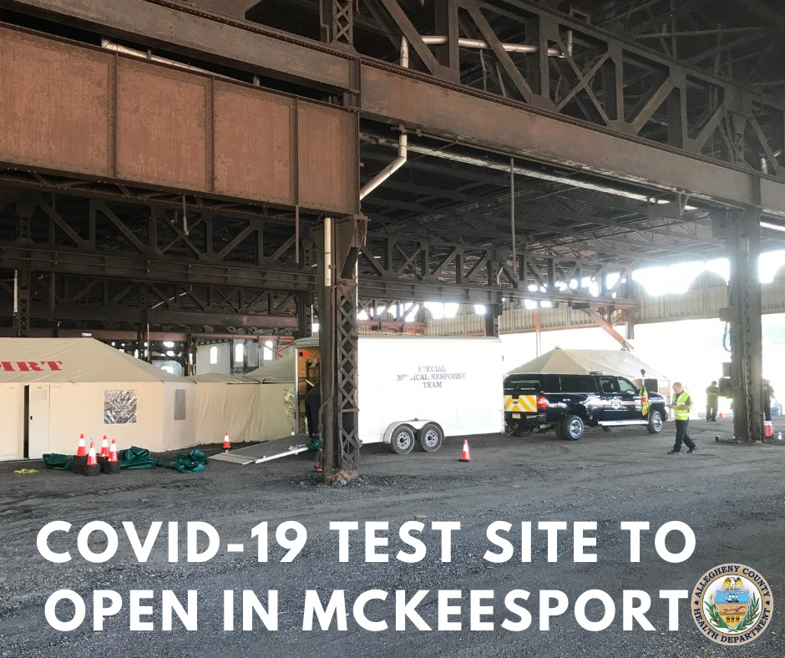
COVID-19 Test Site in McKeesport
Testing site opens to the public on Tuesday, September 15, 2020 at 10 AM
Address: 455 Industry Road, McKeesport
Free COVID-19 Testing for all ages. Made possible by CARES Act funding.
Testing by Appointment Only. This is a drive-thru site with self-administered tests.
If you are unable to drive, contact the COVID-19 Hotline at 1-888-856-2774 for additional options & resources.
Learn more on the Allegheny County News: https://www.alleghenycounty.us/news/index.aspx

Slide 6
COVID-19 Mobile Testing Schedule
Squirrel Hill Health Center
register at http://alleghenycovidtesting.com
Monday, Sept. 14 Leland Point 5230 Wolfe Drive Pittsburgh, PA 15236 (Baldwin)
Tuesday, Sept. 15 Mooncrest Neighborhood Programs 308 Hemlock Drive Moon Township, PA 15108 (Moon)
Wednesday, Sept. 16 Allegheny County Children Youth & Families 10700 Frankstown Road Penn Hills, PA 15235 (Penn Hills)
Thursday, Sept. 17 Parking lot near PNC Bank 119 Butler Street Pittsburgh PA 15209 (Millvale)
Friday, Sept. 18 Jewish Association on Aging 100 JHF Drive, Lower Level Pittsburgh, PA 15217 (Squirrel Hill)
Allegheny Health Network
walk-ins welcome; physicians’ orders are not required
Schedule announced Mondays on
Allegheny County Health Dept Facebook & Twitter
9/16/2020

Slide 7
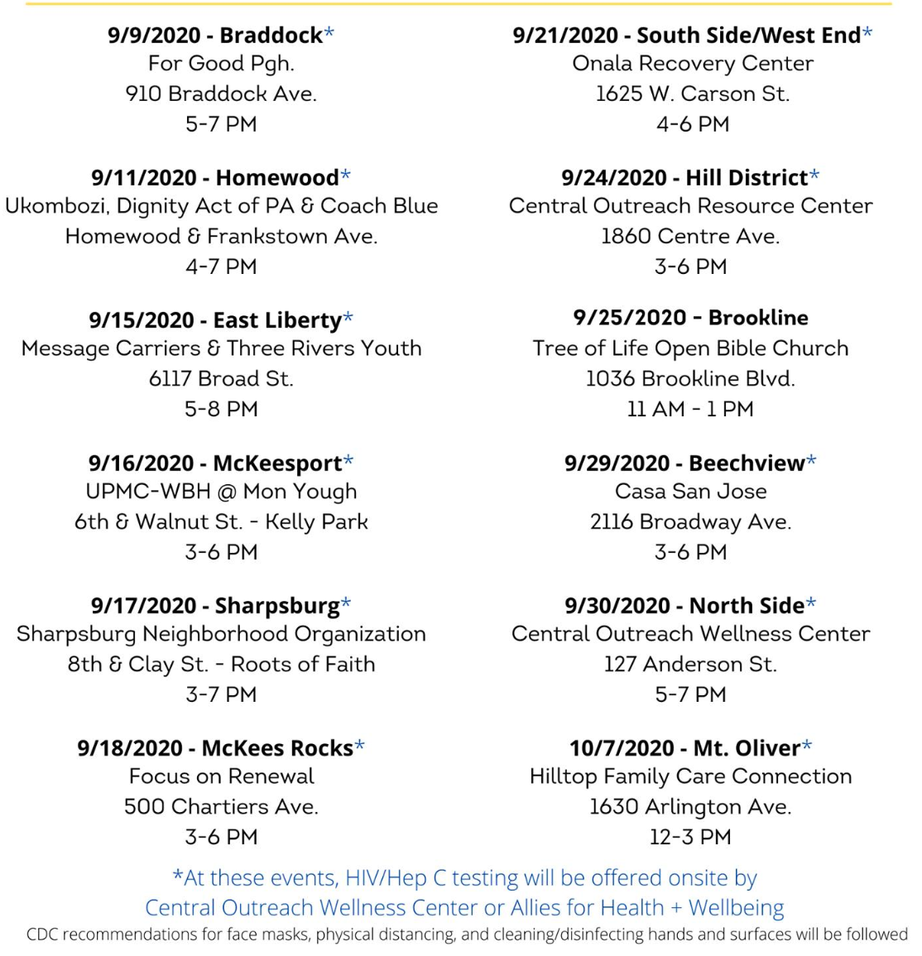
9/10/2020

Slide 8
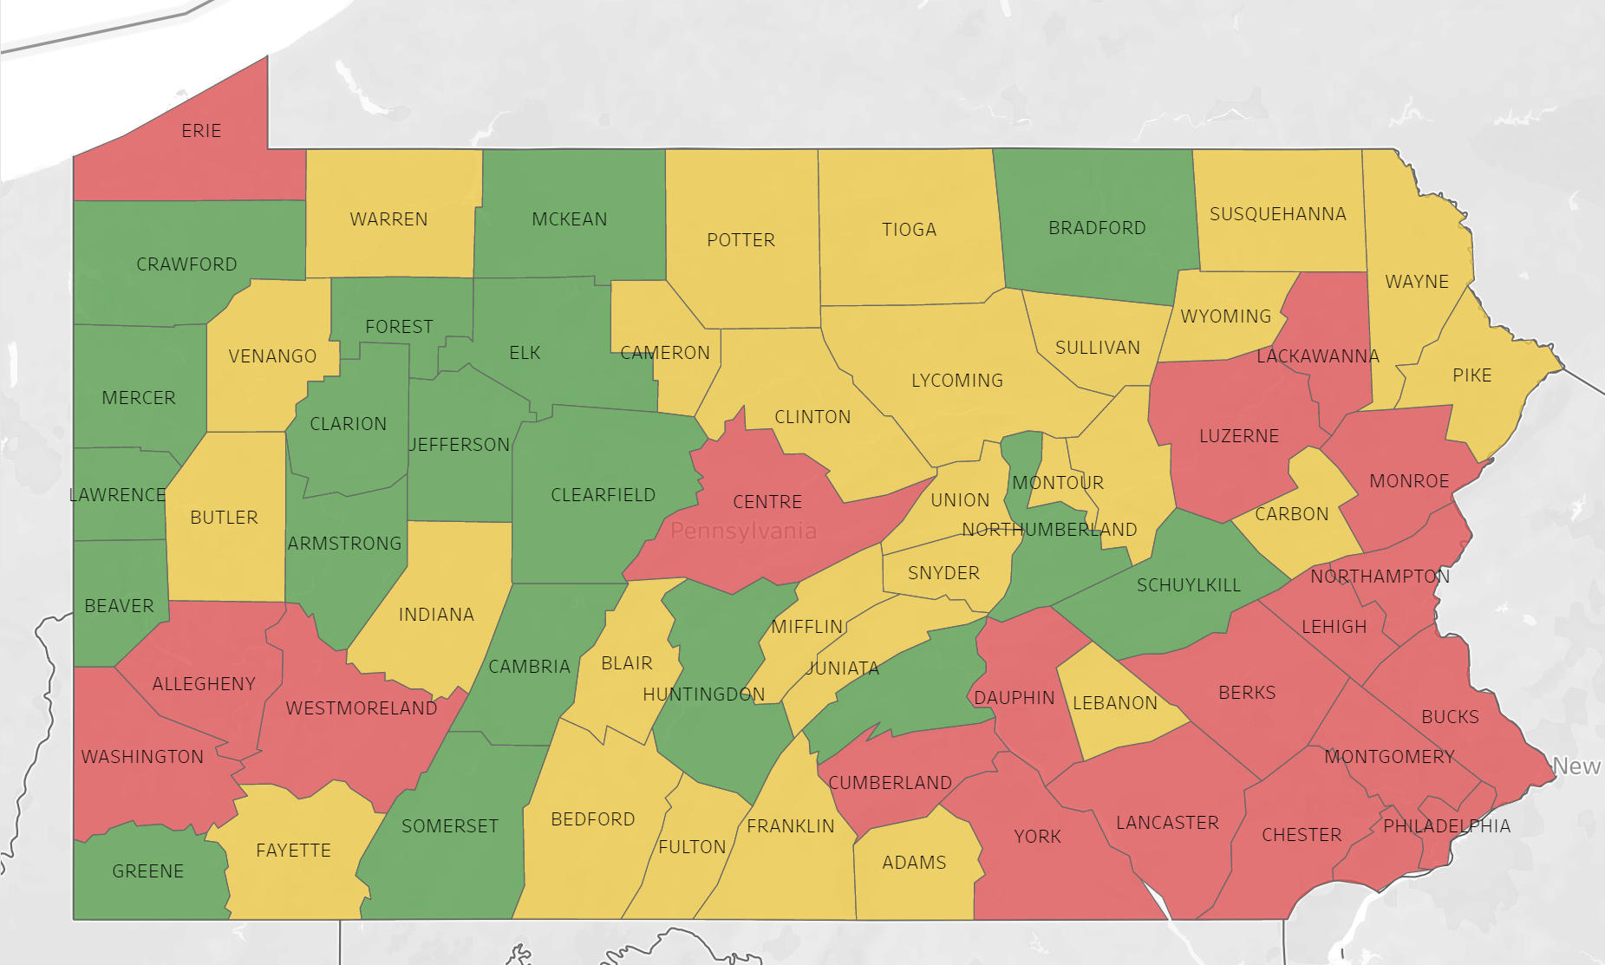
CMU & Voter Protection Corps: Voting Risk Assessment for Allegheny: "Recruit Immediately"

Slide 9
Election Poll Workers Needed
Allegheny County continues to recruit poll workers for the November 3rd election. Poll workers will be provided with "infection prevention kits" for election day that includes a face shield, mask, gloves, disinfectant wipes, and hand sanitizer.
Serve as a Judge, Inspector or Clerk of Election. Election Officers/poll workers earn from $115 to $140 for the day. New Election Officers receive paid training. County website link for more information.
Application for Allegheny County Election Poll Worker
Student Poll Worker Program (not yet updated for November election)
Become a Poll Worker video
Voter resources
Allegheny County Elections Division E-newsletter: Sign-up to receive information on preparations for the November general election
Overview of vote by mail process in Allegheny County
Register to vote
Check voter registration status
Absentee Ballot Application (Spanish): October 27th is the last day to apply for an absentee ballot for the November 3, 2020 election. The application must be received in the Elections office by that date.
Notes:
/23

Slide 10
Additional Help Needed in Elections Division Now
Allegheny County is currently looking for temporary election processing assistants (primarily data processing and clerical work) at $20/hour for various shifts
If interested, call 412-350-6109

Slide 11
There are three ways to fill out the census even while practicing physical distancing:
HAVE YOU FILLED OUT YOUR CENSUS YET?
Please help your community get the resources it needs, by filling out your census today!
VISIT 2020CENSUS.GOV
SPEAK TO A REPRESENTATIVE BY CALLING
1-844-330-2020
FILL OUT A PAPER COPY SENT TO
YOUR HOME

Slide 12
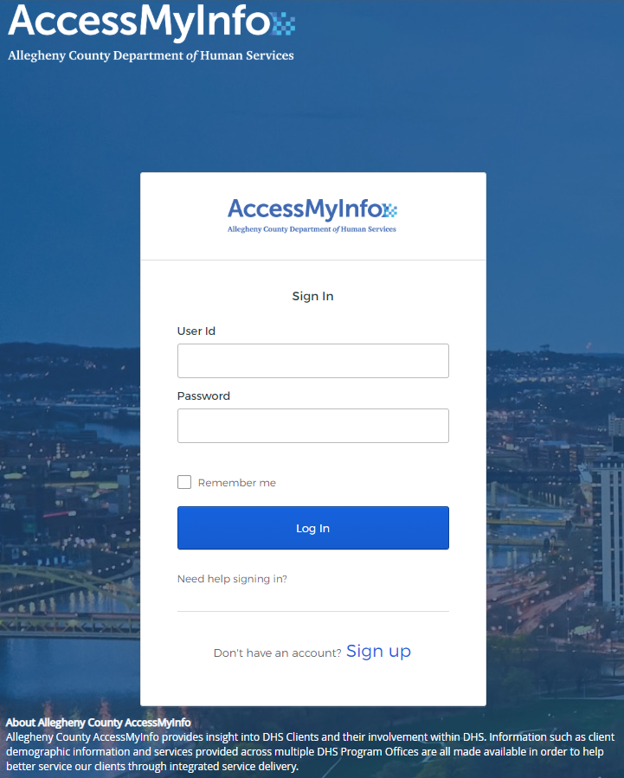
A redesigned social services record system (formerly ClientView for citizens) to provide easier access to personal social services information for residents of Allegheny County
DHS clients (and/or the family members that care for them) can :
Track and coordinate their own treatment and care.
View and better understand the information collected about them
Suggest corrections to certain information

Slide 13
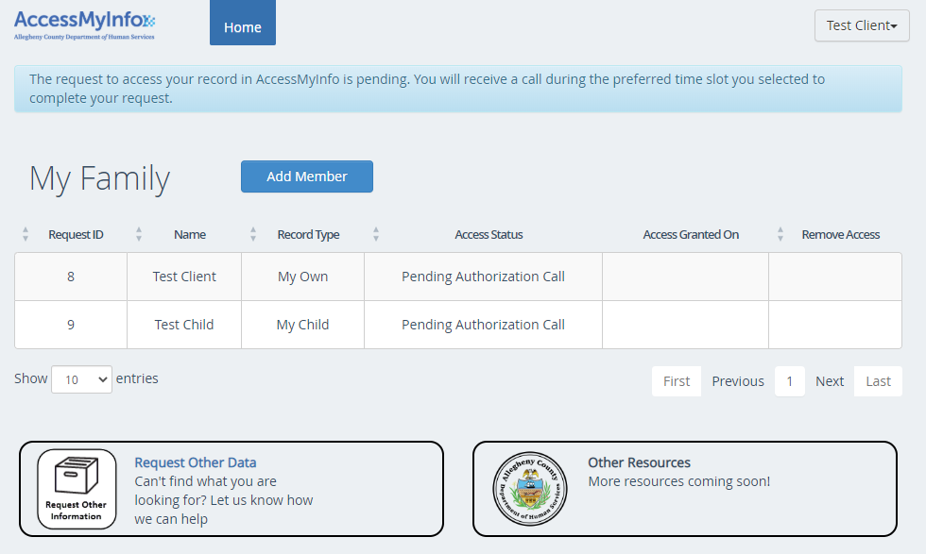
What records can be accessed?
Clients will only be able to access their own records.
Parents can access their own record as well as the records of children under 14 years of age.

Slide 14
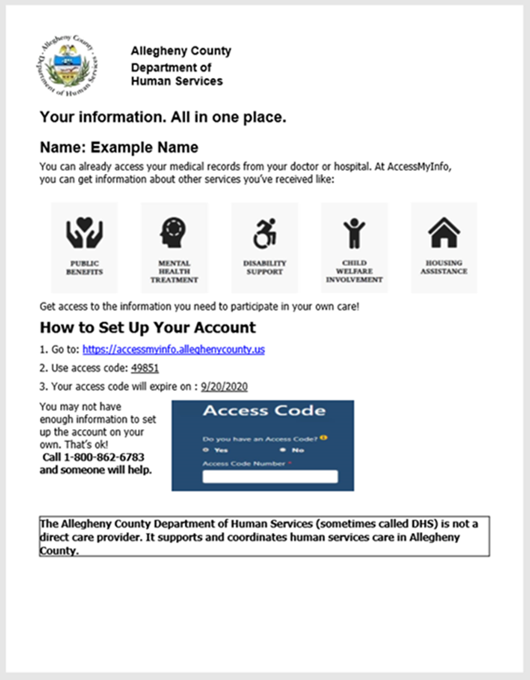
Clients can gain access to their records 3 ways :
1) Follow directions associated with some of the correspondence DHS sends when engaging with clients. These directions are currently sent with:
a) Accept for Service Letter from Child Welfare
b) Case closing Letter from Child Welfare
c) Common Assessment Tool ANSA summary report
d) Self Sufficiency ANSA report
Contact the Directors Action Line for access (800.862.6783 or DAL@alleghenycounty.us)
DHS or Provider staff can generate an access code for clients to create an account and retrieve their records.
If you have any questions, please reach out to our Access My Info Administrator
Email: CVAdmin@alleghenycounty.us or Phone: 412-350-7092

Slide 15
Active Solicitations
RFP for Inpatient Program for Victims of Childhood Sex Trafficking
Renamed in response to community feedback (formerly called “RFP for Inpatient Program for Victims of Commercial Sexual Exploitation of Children”)
Proposals Due September 30 October 14
RFP was amended on 9/14! Budget cap removed and deadline extended
See end of Q&A document for full details on all amendments
RFP for Latinx Community Needs Assessment
Proposals Due September 18 – tomorrow!
Available on DHS Solicitations Page, along with form to sign up to receive email notifications when we post new solicitations
9/17/2020

Slide 16
Policy & Legislative Update – Federal and State
Some new life in 5th COVID-19 stimulus bill talks as the 50-member bipartisan House Problem Solvers Caucus released a $1.5t proposal.
Unclear whether Senate Republicans will cut a deal with the House for a bill larger than the $500b bill that they proposed and was ultimately defeated last week.
Federal District Court judge ruled parts of Governor Wolf's COVID-19 shutdown efforts were unconstitutional earlier this week.
Invalidates parts of Gov. Wolf's early pandemic response, including stay-at-home orders and business closures deemed “non-life-sustaining.” Wolf has since eased many of the restrictions.
Invalidates current state mandated size limits on indoor and outdoor gatherings, saying they violate citizens' constitutional right to assemble (no more than 25 people indoors/no more than 250 people outside).
Gov. Wolf and Attorney General Josh Shapiro are requesting a stay of the order and filing an appeal, especially requesting that the outdoor and indoor limits stand, as overturning them would cause confusion and endanger lives.
Allegheny County Health Department’s indoor/outdoor limits are also threatened by this ruling (but are currently not impacted).
Last Updated: 9/17/20

Slide 17
Policy & Legislative Update – State
Full PA Senate to consider COVID-19 funding-related bills next week.
Bills that have advanced to the floor of the Senate out of Committee so far include the $150 million to assist residential and small business customers with utility payments, and the $200 million to create the Nonprofit Economic Emergency Delivery Systems Grants Program.
These bills must also pass the House before they can be signed by the Governor into law.
PA Office of Unemployment Compensation encourages application as soon as possible for the additional $300/week through the Lost Wages Assistance (LWA) Program as funds will run out quickly.
Individuals currently receiving benefits thru the Pandemic Unemployment Assistance are automatically eligible and do not need to apply. Information on completing Certification here.
Regular unemployment payments continue as usual, though the State is now borrowing from the Federal government in order to make payments as appropriated state funds are depleted.
Last Updated: 9/17/20

Slide 18
Court update
President Judge Clark issued a court order clarifying implementation of the CDC order to temporarily halt certain evictions nationwide (Sept 4 – Dec 31).
The court order includes applicable procedures for instances when the CDC order does not apply, and procedures for when it does.
In general, the CDC order requires a tenant to submit a CDC Declaration form:
Proof from residents that they are using best efforts to obtain government assistance, pay rent to best of ability, and have endured substantial financial loss.
CDC Declaration Form can be found here: https://www.cdc.gov/coronavirus/2019-ncov/covid-eviction-declaration.html.
The CDC order contains detailed information about who is considered a “covered person” under the order.

Slide 19
CARES Coronavirus Relief Fund (CRF)
Activity to Date
Provider Assistance Needed!
Allocated: $38.3M
Contracted: $31.0M
Paid: 6M
Goal – All contracts completed by 9/30/20
Goal – Invoices current as of the October billing deadline
Need help?
Key DHS staff
Payment inquiries: Dan Evancho Dan.Evancho@alleghenycounty.us
Contract inquiries: Kathy Heinz Kathy.Heinz@alleghenycounty.us

Slide 20
Food Distributions
https://www.pittsburghfoodbank.org/get-help/drive-up/

Slide 21
Health Department Guidance
Continue use of PPE and Social Distancing. Recommending that congregate settings quarantine new residents for 2 weeks if they are coming from a high-risk state.
Alabama
Arkansas
Florida
Georgia
Hawaii
Idaho
Illinois
Iowa
Kansas
Louisiana
Mississippi
Missouri
Nevada
North Carolina
North Dakota
Oklahoma
South Carolina
South Dakota
Tennessee
Texas

Slide 22
Monitoring
Due to the COVID-19 pandemic, the 2020 HUD/HAP Annual Monitoring will be completed remotely through virtual conference calls and email exchanges.
Instead of using the traditional monitoring tool, the Bureau of Homeless Services (BHS) is assessing the program to determine if they are high, medium, or low risk. To determine the risk level, the Housing Program Specialists reviewed last year’s monitoring performance as well as this year’s client support concerns, Director’s Action Line complaints and BHS staff intervention.
Risk Levels:
Low: No 2019 CAP and no frequent staff intervention
Medium: No 2019 CAP and yes to frequent staff intervention, Yes 2019 CAP and no to frequent staff intervention
High: Yes 2019 CAP and yes frequent staff intervention

Slide 23
The census
September 22-24: Targeted outreach to people experiencing homelessness in Allegheny County.
Enumerators will be wearing bright orange vests and approaching people at locations within the community including shelters, soup kitchens, possibly camps if locations are known.

Slide 24
Homelessness provider network calls
Every other Tuesday at 9:30 AM
Next call is September 15th.
Topic: Peer Support & psych rehab services - WPH
All homelessness service providers invited and encouraged to participate
Call in information:
Phone number: 1-267-368-7515
Conference ID #: 883 836 652
Ask a Navigator! Office Hours
Every Tuesday from 10:30-11:00AM
1-267-368-7515
Conference ID #: 947 434 365

Slide 25
September is Suicide Prevention and Awareness Month
9/17/2020

Slide 26
There is always…
If you are in crisis or are experiencing difficult or suicidal thoughts, call:
Allegheny County Crisis Response Team (resolve): 1-(888) 796-8226
PA Crisis Line: 1-855-284-2494
National Suicide Hotline at 1-800-273 TALK (8255)
If you’re uncomfortable talking on the phone, you can also text NAMI to 741-741 to be connected to a free, trained crisis counselor on the Crisis Text Line.
If you or someone you know is in a life-threatening emergency, call 911 immediately.
9/17/2020

Slide 27
5th Annual Pittsburgh Recovery Walk – September 19th
To ensure safety, this year’s walk will be semi-virtual
Register in advance to receive a t-shirt in the mail
Walk anywhere on or before September 19 – wearing your Recovery Walk t-shirt
Tag your photos and videos with #MyRoadPGH
Tune in to our livestream on the evening of September 19 for photos and videos from the morning’s walk, inspiring recovery speakers, our annual recovery award ceremony, and more!
Register Here: https://pghrecoverywalk.org/
9/17/2020

Slide 28
Out of the darkness Pittsburgh experience
Date: 10/04/2020
Location: Online – Details TBA
Program Begins: 11:00am
Program Ends: 12:00pm
Contact: Leila Bouabdellaoui at westernpa@afsp.org
https://afsp.org/pittsburgh
9/17/2020

Slide 29
NAMI Walks: October 10th, 2020
Visit: https://www.namikeystonepa.org/nami-events/namiwalks/
9/17/2020

Slide 31
During Child Welfare Worker Appreciation Week September 14-18, 2020, we celebrate you - the people who do so much to empower children, youth, and families facing a variety of life challenges and obstacles. Your hard work and dedication positively impacts and transforms lives, and we can't thank you enough for tackling this challenging work. DETAILS: Join co-hosts NCWWI and the Children’s Bureau for a one-hour virtual recognition event on September 15 at 3 pm ET It's an opportunity to get inspired and refocused on the heart work. Hear from child welfare leaders and service recipients expressing their appreciation for how you've adjusted your practice to serve families and children under such unprecedented and challenging conditions. Register to attend at NCWWI.org/CWworkforce.

Slide 32
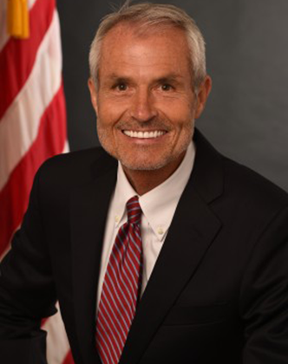
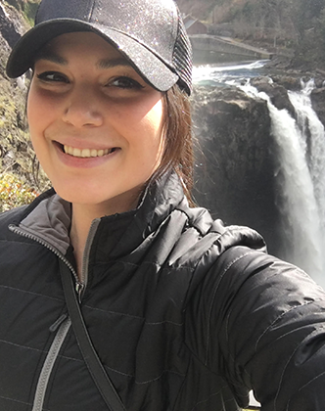
Courtney Canova
Jerry Milner, D.S.W., is the Associate Commissioner at the Children’s Bureau. He brings 43 years of practice, management, and technical assistance experience in child welfare at the local, state, and federal levels. Dr. Milner will speak about these unprecedented times, and the positive impacts we have when we work and learn from one another about how to best serve families.
Lakeya Cherry, DSW, MSSW is the Chief Executive Officer of The Network for Social Work Management, an international membership organization dedicated to strengthening leadership in health and human services. Dr. Cherry is going to lead you in an activity to reflect on all you have already done that is remarkable and get you thinking about how you'll continue that momentum forward.
Victor Sims’ story is one of beating incredible odds to achieve success, then using that success to give back to some of our most vulnerable children. He has seen child welfare from every angle - foster child, case manager, resource parent, and currently as the Case Management Teen Program Supervisor for SailFuture - giving him a deep understanding of the system. Victor was named a Child Defender Fellow by the Children’s Defense Fund, a Reunification Hero by the American Bar Association, and most recently received a 2020 Casey Excellence for Children Award. You will not want to miss his inspirational talk about how you're making a difference by showing up!
Using her lived experience in foster care, Courtney has made an incredible impact by both working within and advocating for changes to the child welfare system. Recognized as an Outstanding Young Leader by Foster Club in 2019, she continues to elevate the voices of parent allies and youth in care by partnering with a variety of legislative coalitions and service providers. Through her personal story, Courtney will share with us the importance of showing up for youth, addressing secondary trauma, and self-care.

Slide 34
CYF Local Activities: *Annual All-Staff training turned into a week of development *Daily lunch virtual meetings with leadership and Judges for “get to know you” activities *Emphasis on wellness and recognition *Continued conversations with staff of color designed to push forward an Anti-Racist Agency *Each regional office hosting weekly developmental sessions or activities focusing on Equity

Slide 35
Key Contacts
Provider questions for Allegheny County Health Department
DHS-COVID19Planning@alleghenycounty.us
Use the subject field to indicate if your qq is about CYF, Aging, BH, CYF, ID, Community Services, or DHS operations (e.g., contracting, payment)
https://www.alleghenycounty.us/healthdepartment/index.aspx
Key DHS staff
Payment inquiries: Dan Evancho Dan.Evancho@alleghenycounty.us
Contract inquiries: Kathy Heinz Kathy.Heinz@alleghenycounty.us
Laura Brigido Laura.Brigido@alleghenycounty.us
United Way 2-1-1
For basic needs assistance or general COVID-19 inquiries call the 24/7 COVID-19 Hotline at 1-888-856-2774. Language services are available.
Last Updated: 3/20/20

